Slide 1
App Development using React
By
Krishna Chaitanya Chamarthi (E23BCAU0012)
Parth Rana (E23BCAU0109)

Slide 2
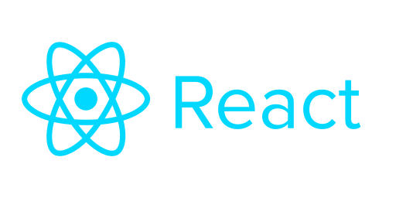
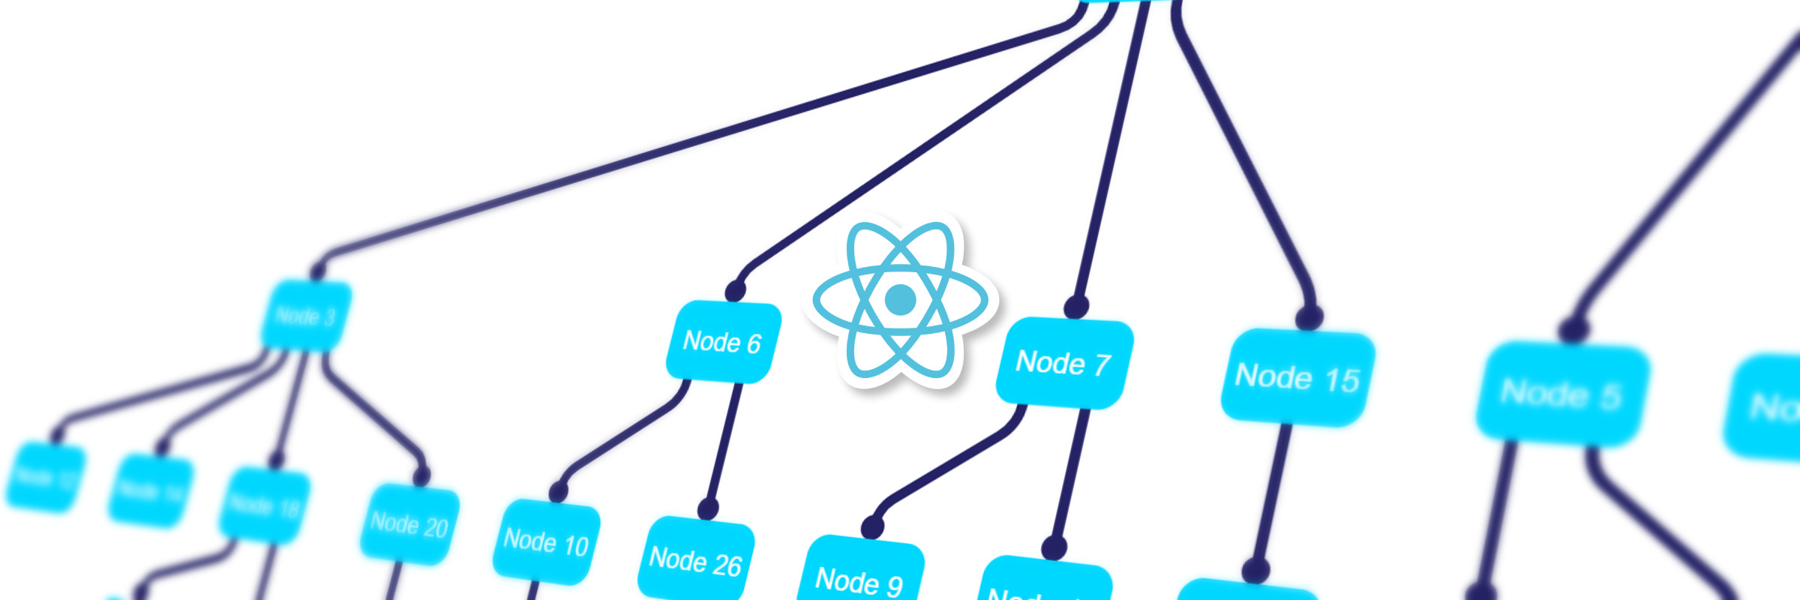

Slide 3
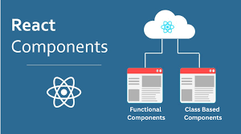

Slide 4
To use React :
1. To Install Node.js and npm
React requires Node.js and npm (Node Package Manager) to manage dependencies and run the app.
Steps are as follows:
Download and Install Node.js:
Go to the official Node.js website.
Download the LTS (Long Term Support) version for your operating system.
The Node.js installer will also install npm (Node Package Manager) automatically.
Verify Installation: After installation, open a terminal (Command Prompt on Windows, Terminal on macOS/Linux) and check that Node.js and npm are installed by running:
node -v
npm –v
These commands print the installed versions of Node.js and npm.

Slide 5
2. To Install Create React App
To quickly set up a new React project, we use Create React App, a tool that generates the basic structure of a React app with all the necessary configurations.
We then Open a terminal and run the following command:
npx create-react-app my-app
Replace my-app with the name of project.
npx is a tool that comes with npm (since version 5.2) and allows to run commands from packages without installing them globally.

Slide 6
3. To Navigate to Project Folder
Once the command completes, you'll have a new directory with the name you provided (my-app). Navigate into that folder:
cd my-app
4. To Start the Development Server
To start the development server and launch the React app in the browser, run:
npm start
This will open our default browser and show the app running at http://localhost:3000

Slide 7
5. To Open and Edit Our React App
Open the project folder (my-app) in any code editor (e.g., Visual Studio Code, Sublime Text, Atom, etc.).
Inside the src folder, we'll find a file named App.js.
This is where we can start editing our React components

Slide 8
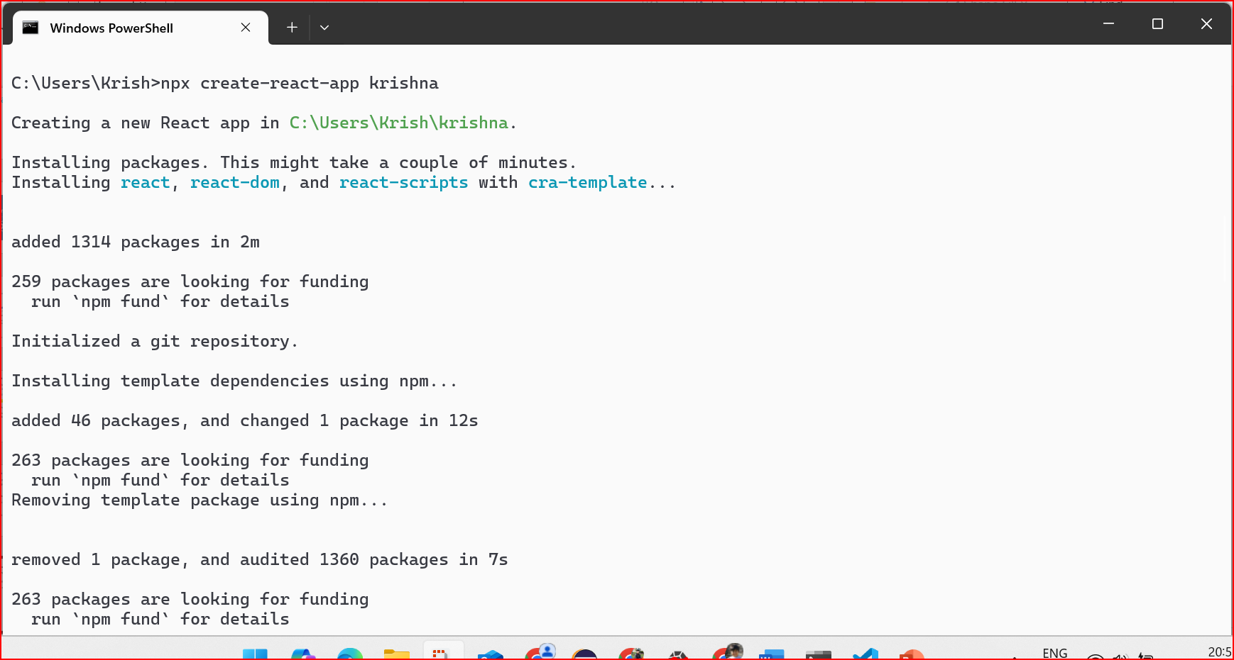

Slide 9
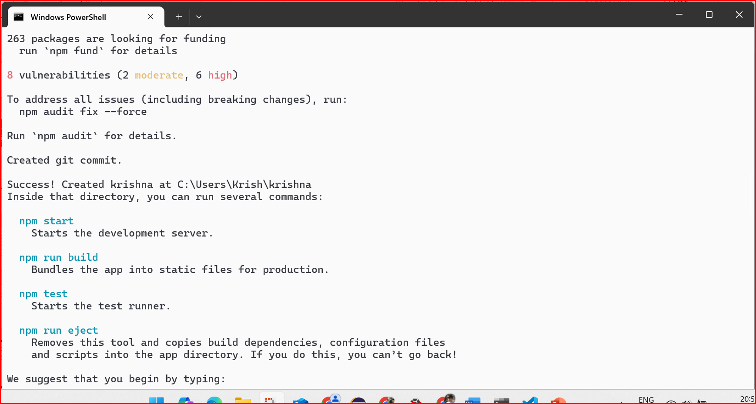

Slide 10
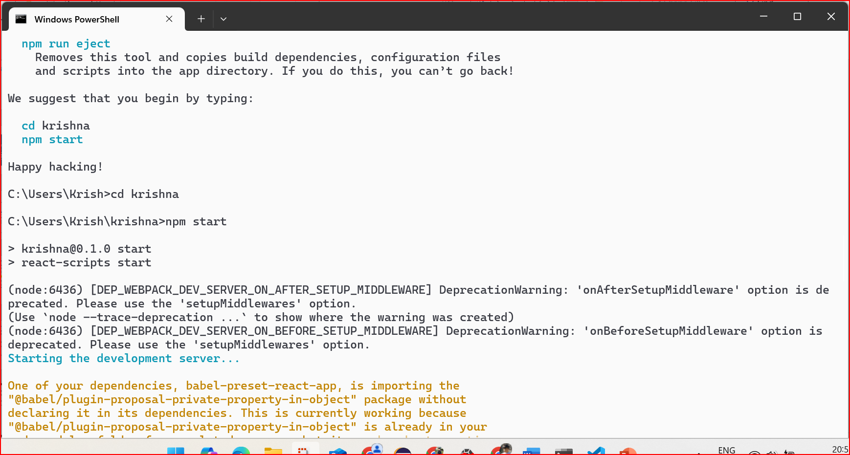

Slide 11
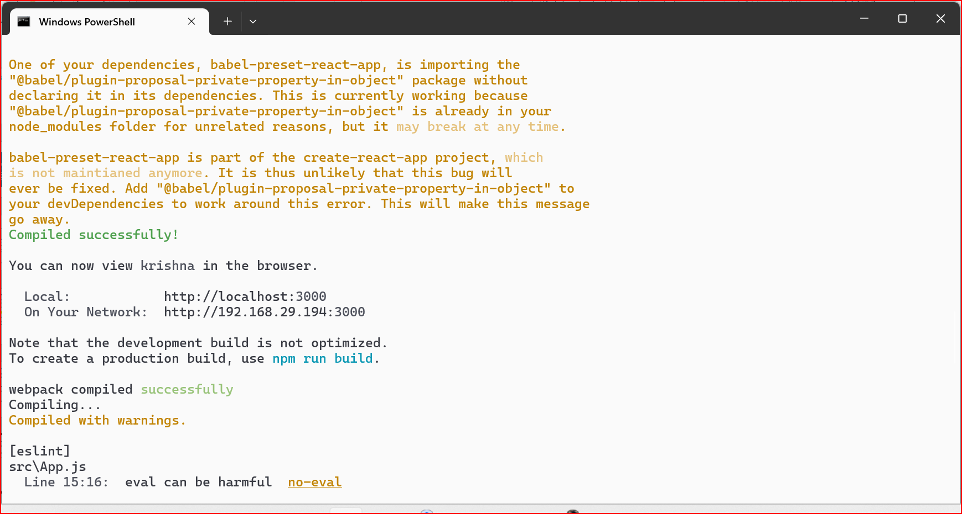

Slide 12
App.js and App.css files are created
The Codes for both are attached

Slide 13
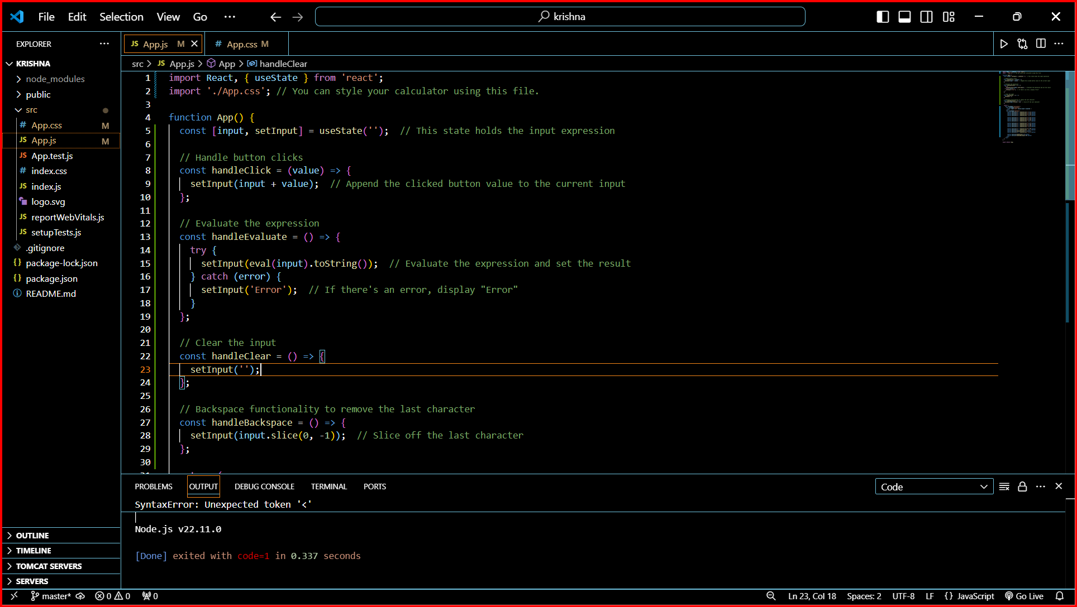

Slide 14
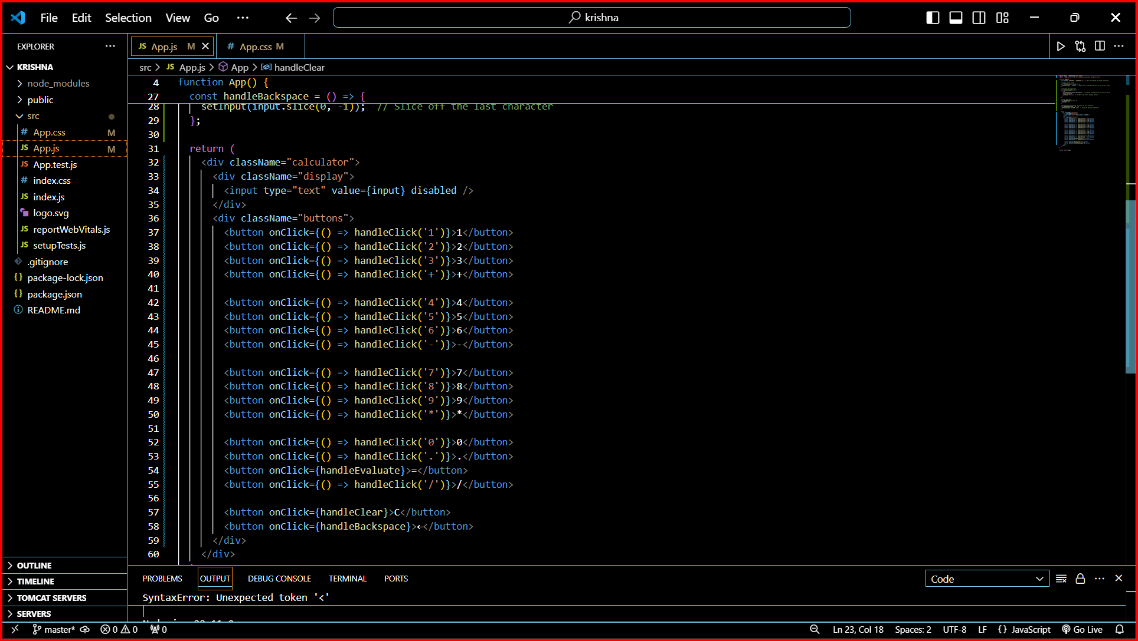

Slide 15
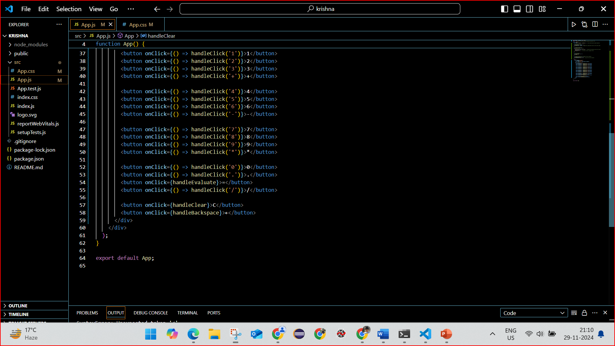

Slide 16
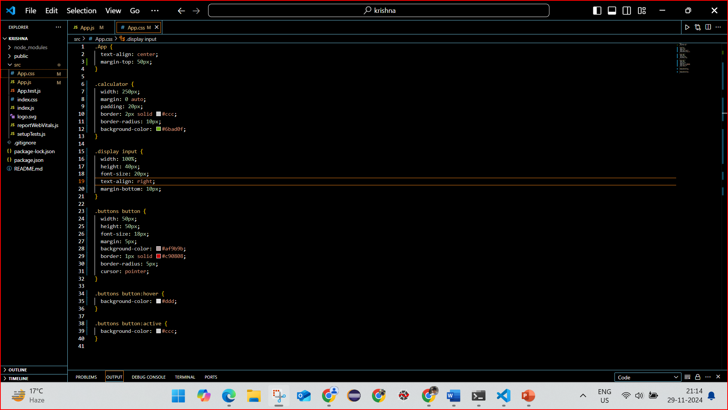

Slide 17
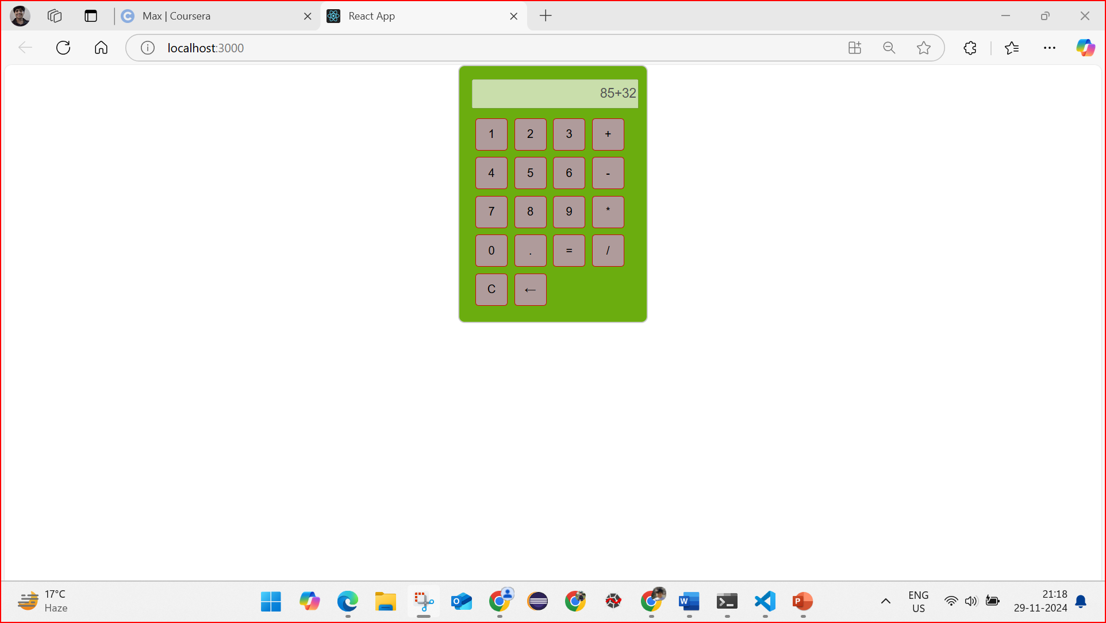

Slide 18
